Slide 1
Variable Rate Image Compression with Recurrent Neural Networks George Toderici, Sean M. O'Malley, Sung Jin Hwang, Damien Vincent, David Minnen, Shumeet Baluja, Michele Covell, Rahul Sukthankar ICLR 2016
Rong Wenxun
30 November, 2018

Slide 2
INTRODUCTION
1

Slide 3
BACKGROUND
A large fraction of Internet traffic is now driven by requests from mobile devices with relatively small screens and often stringent bandwidth requirements. Due to these factors, it has become the norm for modern graphics-heavy websites to transmit low-resolution, low-bytecount image previews (thumbnails) as part of the initial page load process to improve apparent page responsiveness.
Large-scale compression of thumbnails (e.g., 32×32 images) is an important application, both in terms of reducing disk storage and making better use of limited Internet bandwidth. Enormous numbers of thumbnails are currently transmitted across the web for page previews, photo galleries, search engine results, and numerous other applications. As such, any improvements to thumbnail compression will significantly improve the experience of users accessing content over low-bandwidth connections.

Slide 4
BACKGROUND
All these efforts such as the ubiquitous JPEG, JPEG 2000 and WebP image formats approach the compression problem from an empirical standpoint:
human experts design various heuristics to reduce the amount of information needing to be retained, then determine ways to transform the resulting data in a way that’s amenable to lossless compression.
(1) As this work is almost exclusively focused on the compression of large images, low-resolution thumbnail images are usually ignored;
(2) We usually assume that a patch from a high-resolution natural image will contain a lot of redundant information. In fact, the higher-resolution an image is, the more likely it is that its component patches will contain mostly low-frequency information. This fact is exploited by most image codecs and, as such, these codecs tend to be very efficient at compressing high-resolution images.However, such assumptions are broken when creating thumbnails from high-resolution natural images, as a patch taken from a thumbnail is much more likely to contain difficult-to-compress, high-frequency information.

Slide 5
Contribution of this paper
we propose a general framework for variable-rate image compression and a novel architecture based on convolutional and deconvolutional LSTM recurrent networks. Our models address the main issues that have prevented autoencoder neural networks from competing with existing image compression algorithms:
(1) our networks only need to be trained once (not per-image), regardless of input image dimensions and the desired compression rate;
(2) our networks are progressive, meaning that the more bits are sent, the more accurate the image reconstruction;
(3) the proposed architecture is at least as efficient as a standard purpose-trained autoencoder for a given number of bits.

Slide 6
Variable Rate Compression Architechtures
2

Slide 7
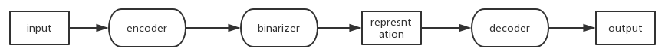
AUTOENCODER
For each architecture, we will discuss a encoder function E that takes an image patch as input and produces an encoded representation.
This representation is then processed by a binarization function B, which is the same across architectures.
Finally, for each architecture we also consider a decoder function D, which takes the binary representation produced by B and generates a reconstructed output patch.
Taken together, these three components form an autoencoder, x' = D(B(E(x))), which is the basic building block for all of the compression networks.

Slide 8

IMAGE COMPRESSION FRAMEWORK
To make it possible to transmit incremental information, the design should take into account the fact that image decoding will be progressive. With this design goal in mind, we can consider architectures that are built on top of residuals with the goal of minimizing the residual error in the reconstruction as additional information becomes available to the decoder.
Formally, we chain multiple copies of a residual autoencoder, Ft, defined
In all cases, we set r₀ to be equal to the original input patch, and then r_{t} for t > 0 represents the residual error after t stages.

Slide 9


IMAGE COMPRESSION FRAMEWORK
For non-LSTM architectures, Ft has no memory, and so we only expect it to predict the residual itself. In this case, the full reconstruction is recovered by summing over all of the residuals, and each stage is penalized due to the difference between the prediction and the previous residual:
On the other hand, LSTM-based architectures do hold state, and so we expect them to predict the original image patch in each stage. Accordingly, we compute the residual relative to the original patch:
In both cases, the full, multi-stage network is trained by
where N is the total number of residual autoencoders in the model.

Slide 10
BINARY REPRESENTATION
This binarization has three benefits:
(1) bit vectors are trivially serializable/deserializable for image transmission over the wire;
(2) control of the network compression rate is achieved simply by putting constraints on the bit allowance;
(3) a binary bottleneck helps force the network to learn efficient representations compared to standard floating-point layers, which may have many redundant bit patterns that have no effect on the output.
The binarization process consists of two parts:
(1)generating the required number of outputs (equal to the desired number of output bits) in the continuous interval [−1, 1]. We use a fully-connected layer with tanh activations:
(2)taking this real-valued representation as input and producing a discrete output in the set {−1, 1} for each value.

Slide 11

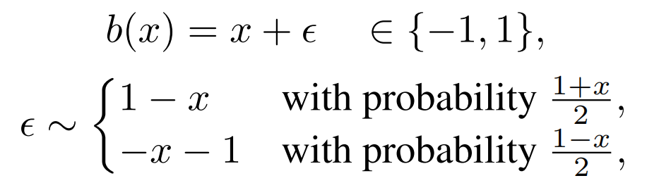

BINARY REPRESENTATION
In order to have a fixed representation for a particular input, once the networks are trained, only the most likely outcome of b(x) is considered and b can be replaced by b inf defined as:
where W^{bin} and b^{bin} are the standard linear weights and bias that transform the activations from the previous layer in the network.
In all of our models, we use the above formulation for the forward pass. For the backward pass of back-propagation, we take the derivative of the expectation. Since E[b(x)] = x for all x ∈ [−1, 1], we pass the gradients through b unchanged.

Slide 12
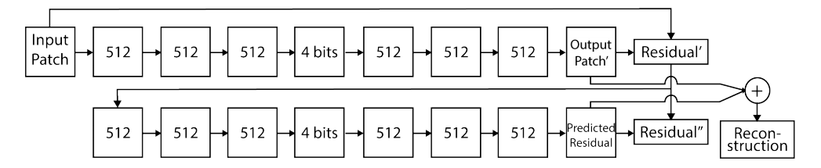
(1)FEED-FORWARD FULLY-CONNECTED RESIDUAL ENCODER
In the simplest instantiation of our variable rate compression architecture, we set E and D to be composed of stacked fully-connected layers.
We depict a two-iteration architecture, with the goal of the first iteration being to encode the original input patch and the goal of the second iteration being to encode the residual from the first level’s reconstruction.
In our 64-bit results, we have 16 iterations giving 4 bits each. The blocks marked with 512 are fully-connected neural network layers with 512 units and tanh nonlinearities. The loss applied to the residuals in training is a simple L2 measure.

Slide 13
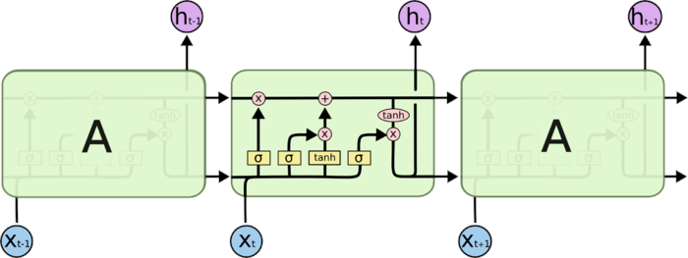
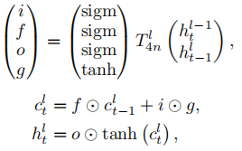
(2)LSTM
we use superscripts to indicate the layer number, and subscripts to indicate time steps.
Let h^{l}_{t} ∈ R^{n} denote the hidden state of l-th LSTM layer at time step t. We define T^{l}_{n}: R^{m} → R^{n}to be an affine transform T^{l}_{n}(x) = W^{l}x + b^{l}.
Finally, let ☉ denote element-wise multiplication, and let h⁰_{t} be the input to the first LSTM layer at time step t.
where sigm(x) = (1 + exp(-x))⁻¹ denotes the sigmoid function.

Slide 14
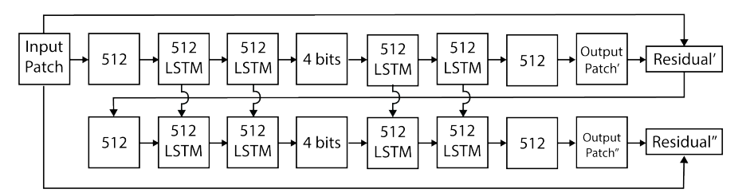
LSTM-BASED COMPRESSION
In this architecture, we explore the use of LSTM models for both the encoder and the decoder. In particular, both E and D consist of stacked LSTM layers.
The vertical connections between the LSTM stages in the unrolling shows the effect of the persistent memory instead each LSTM. The loss is applied to the residuals in training is a simple L2 measure. Note that in contrast to Figure 1, in which the network after the first step is used to predict the previous step’s residual error, in this LSTM architecture, each step predicts the actual output

Slide 15
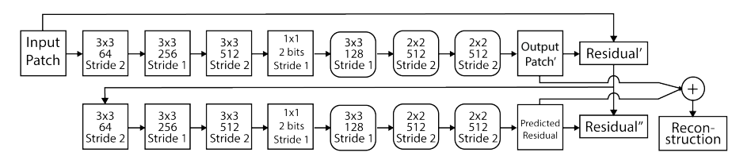
(3)FEED-FORWARD CONVOLUTIONAL/DECONVOLUTIONAL RESIDUAL ENCODER
We extend this architecture by replacing the fully-connected layers with convolution operators in the encoder E and with deconvolutional operators in the decoder D.
The final layer of the decoder consists of a 1×1 convolution with three filters that converts the decoded representation into RGB values.

Slide 16

CONVOLUTIONAL/DECONVOLUTIONAL
The deconvolutional operator is defined as the transpose of the convolutional operator.
Let ⊗_{k} denote the convolutional operator with stride k, and let S_{k} denote the stride operator with stride factor k, i.e.,
S_{k}(x)(i, j) = x(k × i, k × j) for 2D multi-channel image x and pixel coordinate (i, j).
Then,
Note that the transpose of S_{k} is the “inflation” operator T_{k}:
Thus, we can define the deconvolutional operator with stride k as follows:

Slide 17
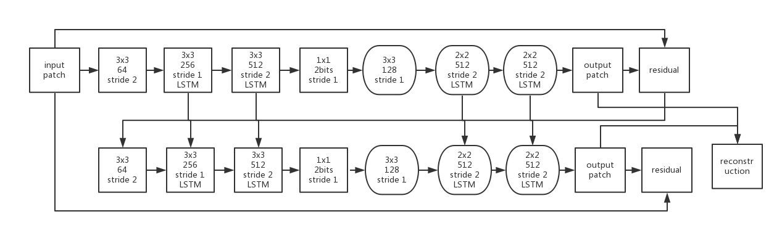
(4)CONVOLUTIONAL/DECONVOLUTIONAL LSTM COMPRESSION
The final architecture combines the convolutional and deconvolutional operators with LSTM

Slide 18
(4)CONVOLUTIONAL/DECONVOLUTIONAL LSTM COMPRESSION
The final architecture combines the convolutional and deconvolutional operators with LSTM.Then the transformation function for convolutional LSTM with stride k is:
For the decoder, we cannot replace all convolutional operations with deconvolution due to the fact that the input to deconvolution often has a different spatial dimension than the output.
Here we use the subscripts c and d to differentiate between the weights associated to the convolution and deconvolution operations.

Slide 19
EXPERIMENTS & ANALYSIS
3

Slide 20
(1)TRAINING SET
In order to train the various neural network configurations, we used the Adam algorithm proposed by Kingma & Ba (2014).
We experimented with learning rates of {0.1, 0.3, 0.5, 0.8, 1}. The L2 loss was normalized by the number of pixels in the patch and also by the number of total time steps (i.e., number of iterations unrolled) needed to fully encode the patch.During training we used the unmodified L2 error measure.
We experimented with the number of steps needed to encode each patch, varying this from 8 to 16. For the fully connected networks, we chose to use 8 bits per step for an 8×8 patch, allowing us to fine tune the compression rate in increments of 8 bits. When scaled up to a 32×32 patch size, this allowed us to control the compression in increments of 128 bits.

Slide 21
(2)EVALUATION PROTOCOL AND METRICS
In our evaluation protocol we instead employ the Structural Similarity Index (SSIM), a popular perceptual similarity measure proposed by Wang et al. (2004).
Since we’re evaluating compression performance on small 32×32 images, we do not smooth the images (a typical preprocess for SSIM). In addition, since we’re interested in quantifying how well local details are preserved, we split the images into 8×8 patches and compute the SSIM on each patch and on each color channel independently. The final score is the average SSIM over all patches and channels.
When analyzing the results, a higher score implies a better reconstruction, with a score of 1.0 representing a perfect reconstruction. The lowest possible score is 0.0.

Slide 22
(3)32×32 BENCHMARK
Our 32×32 benchmark dataset contains 216 million random color images collected from the public internet. To be included in the dataset, each image must originally have more than 32 pixels on both axes.
Qualified images were then downsampled to 32×32, losing their original aspect ratios. This downsampling eliminates pre-existing compression artifacts for most images. The final 32×32 images were then stored losslessly (as PNG) before being used for training and testing. For training the LSTM models, 90% of the images were used; the remaining 10% were set aside for evaluation. For evaluating the image codecs, we use a subset of this data containing 100k random images.
To avoid unfairly penalizing the codecs due to the unavoidable cost of their file headers, we exclude the header size from all metrics. Note also that since these standard codecs can not be tuned to an exact byte budget (e.g., 64 bytes excluding the file header), we search for the encoder quality setting that leads to a file whose size is as close as possible, but never less than, the target size. On average, this leads to each JPEG and WebP image consuming slightly more space than we allow for the LSTM models.

Slide 23
(3)32×32 BENCHMARK
Our 32×32 benchmark dataset contains 216 million random color images collected from the public internet. To be included in the dataset, each image must originally have more than 32 pixels on both axes.
Qualified images were then downsampled to 32×32, losing their original aspect ratios. This downsampling eliminates pre-existing compression artifacts for most images. The final 32×32 images were then stored losslessly (as PNG) before being used for training and testing. For training the LSTM models, 90% of the images were used; the remaining 10% were set aside for evaluation. For evaluating the image codecs, we use a subset of this data containing 100k random images.

Slide 24
RESULTS
4

Slide 25
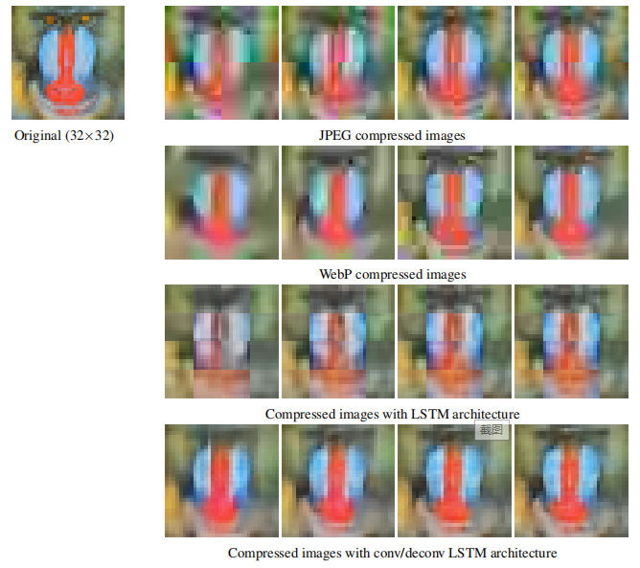
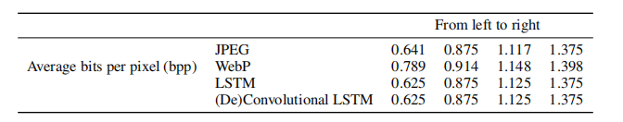

Slide 26
RESULTS
As can be seen in Figure 4, compressing these images without destroying salient visual information or hallucinating false details is challenging. At these very low bitrates and spatial resolution, JPEG block artifacts become extremely prominent, and WebP either introduces blocking or overly blurs the image depending on the strength of the internal filter.
Compared to JPEG, the non-convolutional LSTM model slightly reduces inter-block boundaries on some images but can also lead to increased color bleeding (e.g., on mandrill as shown in Figure 4). This motivates the (de)convolutional LSTM model, which eliminates block artifacts while avoiding excessive smoothing. It strikes the best balance between preserving real detail and avoiding color smearing, false gradients, and hallucinated detail not present in the original image.

Slide 27
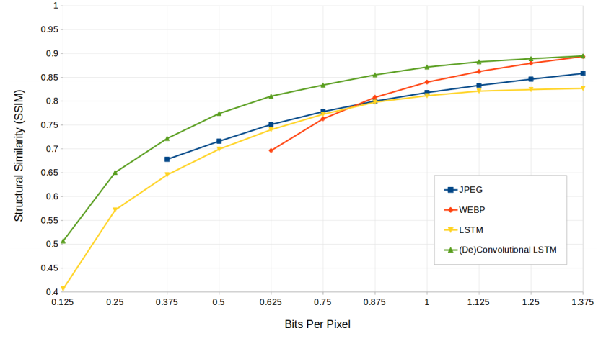
Figure 5: Rate-distortion graph showing the SSIM for different codecs at different target bit rates.The results are averaged over 100k images for JPEG and WebP and over a 10% hold-out set of over 21 million images for the two LSTM models. The (de)convolutional LSTM model provides the highest SSIM across all low bit rates, though we expect WebP to provide better SSIM at higher bit rates.

Slide 28
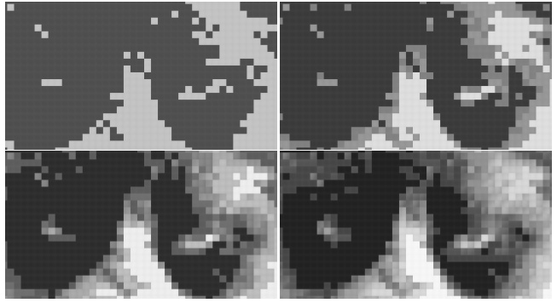
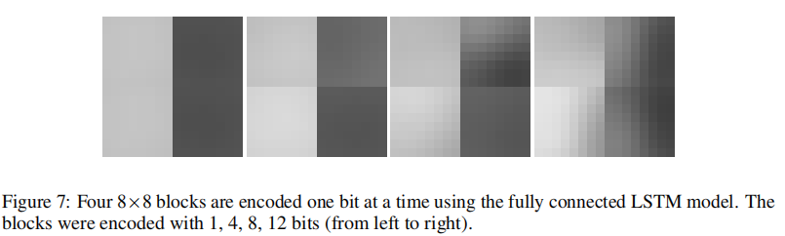
Figure 6: The effect of the first four bits on compressing a cat image. The image on the top left has been created by using a single bit for each 8×8 block. The subsequent images add one additional bit to be processed by the LSTM decoder. The final image (bottom right) has been created by running four steps of the algorithm, thus allowing a total of four bits to be used to encode each 8×8 block.
Figure 7: Four 8×8 blocks are encoded one bit at a time using the fully connected LSTM model. The blocks were encoded with 1, 4, 8, 12 bits (from left to right).

Slide 29
CONCLUSION & FUTURE WORK
4

Slide 30
CONCLUSION & FUTURE WORK
While our current approach gives favorable results versus modern codecs on small images, codecs that include an entropy coder element tend to improve (in a bits-per-pixel sense) with greater resolution, meaning that by choosing an arbitrarily large test image it is always possible to defeat an approach like that described in this work. Therefore, an obvious need is to extend the current work to function on arbitrarily large images, taking advantage of spatial redundancy in images in a manner similar to entropy coding.
Another topic for future work is determining a dynamic bit assignment algorithm that is compatible with the convolutional methods we present, while not creating such artifacts.
The algorithms that we present may also be extended to work on video, which we believe to be the next grand challenge for neural network-based compression.

Slide 31
Thank you for listening

